Slide 1
Assignment 3: User story, use cases and mockup screen
Online shopping system group:
Donna Jackson
Leshan Zhao
Mehnaz Tabassum
Ravindra Joshi

Slide 2
User story:
As a customer, I would like to buy a new broom
Use case: Search for a product
Related use cases: Generalization of:
• Searching the product by typing name
• Searching the product by typing the usage scenario or description of the product
Steps:
Actor actions | System responses
1. Select a category, or leave it as default. | Show the drop-down box and show the available categories
2. In the input box, type in the name of item or describe the item/scenario he want, then click “search” | Browse the database and list the most related items.
3. Select on items and click “View more” | Guide the user to the detail page of selected item

Slide 3
Step 1
All
Enter or describe the item you want here
Search
All
Enter or describe the item you want here
Search
Food
Medicine
Clothing
Household
…
All
Enter or describe the item you want here
Search
Food
Medicine
Clothing
Household
…

Slide 4
Step 1
All
Enter or describe the item you want here
Search
Food
Medicine
Clothing
Household
…
Household
Search
Step 2
Household
Broom
Search
Household
Broom
Search

Slide 5
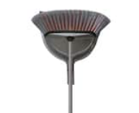
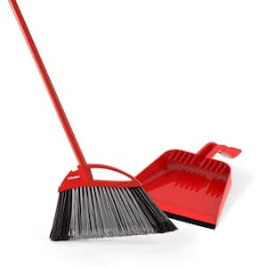
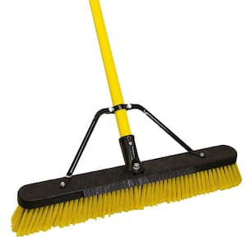
Step 3
Household
Broom
Search
HDXSmooth Sweep Indoor Angle Broom with Dustpan
Buy Now
View more
$ 11.97
Add to Cart
O-CedarPowerCorner Pet Pro Angle Broom with Step On Dust Pan
Buy Now
View more
Add to Cart
$ 13.97
QuickieJobsite 24 in. Multi-Surface Fiberglass Push Broom
Buy Now
View more
$ 36.97
Add to Cart
Notes:
Images come from https://www.homedepot.com/b/Cleaning-Cleaning-Tools-Brooms/N-5yc1vZcb2s

Slide 6
Step 3
Household
Broom
New Search
Back
HDXSmooth Sweep Indoor Angle Broom with Dustpan
11 in stock
$ 11.97
Description:
With this HDX Broom you will enjoy an effective and efficient sweeping experience with minimal labor. The smooth soft bristles are perfect for cleaning pet hair, dirt and dust from floors. Use for indoor sweeping on wood, tile, linoleum floors. Comes with dustpan 13 in. dustpan with rubber lip for fast and easy dirt collection into the pan and not under it. The dustpan also features shark teeth on the sides to help clean hair and dirt particles from the bristles.
Specifications:
Dimensions
Handle Length (in.) | Product Depth (in.) | Product Width (in.)
47 | 2.25 | 15.50
Comments (0):
Add to Cart
Buy Now
Notes:
Images and info come from https://www.homedepot.com/p/HDX-Smooth-Sweep-Indoor-Angle-Broom-with-Dustpan-2060/307897613

Slide 7
User story:
As a seller, I would like to sell my idle broom (brand new)
Use case: Launch a new product on the system
Related use cases: Generalization of:
• The seller is a merchant
• The seller is a common people and is selling an idle brand new product or used product
Steps:
Actor actions | System responses
1. Select a category, or leave it as default. | Show the drop-down box and show the available categories
2. In the input box, type in the name of item to be launched (the name which will be displayed in customers’ lists) and click “Add new”. | A new entry will be created in the system’s database, but this new item hasn’t been released yet. A new window will show up to ask the seller provide more info.
3. Enter more information that the seller wants the customers to see. The seller should at least indicate whether the item is used or not. Then, click “Lauhcn New”. | The new entry is now released (launched) and will be visible to customers. The seller will be prompt that the new item has been launched, but has not been authenticated, and there will be a choice “apply for authentication now”.

Slide 8
Step 1
Any
Enter the name of item you want to launch here
Add New
Any
Enter the name of item you want to launch here
Add New
Any
Food
Medicine
Clothing
Household
…
Any
Enter the name of item you want to launch here
Add New
Any
Food
Medicine
Clothing
Household
…

Slide 9
Step 1
Any
Enter the name of item you want to launch here
Add New
Any
Food
Medicine
Clothing
Household
…
Household
Enter or describe the item you want here
Add New
Step 2
Household
Add New
Household
Quickie2-in-1 Squeegee Push Broom Model# 635SU
Add New
Household
Quickie2-in-1 Squeegee Push Broom Model# 635SU
Add New
Notes:
Images come from https://www.homedepot.com/b/Cleaning-Cleaning-Tools-Brooms/N-5yc1vZcb2s

Slide 10
Step 3
*Item name:
Quickie2-in-1 Squeegee Push Broom Model# 635SU
Category:
Household
Item image:
Preview image:
Description:
Enter the name of item you want to launch here
Features:
Add new feature
*Used?
Yes
No
Launch New

Slide 11
Step 3
*Item name:
Quickie2-in-1 Squeegee Push Broom Model# 635SU
Category:
Household
Item image:
Preview image:
Description:
Enter the name of item you want to launch here
Features:
Add new feature
*Used?
Yes
No
Launch New

Slide 12
Step 3
*Item name:
Quickie2-in-1 Squeegee Push Broom Model# 635SU
Category:
Household
Item image:
Preview image:
Description:
Enter the name of item you want to launch here
Features:
Add new feature
*Used?
Yes
No
Launch New

Slide 13
Step 3
Your item has been successfully added to the system, but hasn’t been authenticated by our stuffs. Do you want to apply for authentication now? This could take 1 to 7 business days.
Apply for authentication now

